Slide 1
Concept of Engineering Economy

Slide 2



Engineering Economy
Is about Money
Involves many choices among alternative designs, procedures, plans, and methods
Asks the question “Will it pay?”
Judges whether any proposed course of action will prove to be economical as compared to others

Slide 3

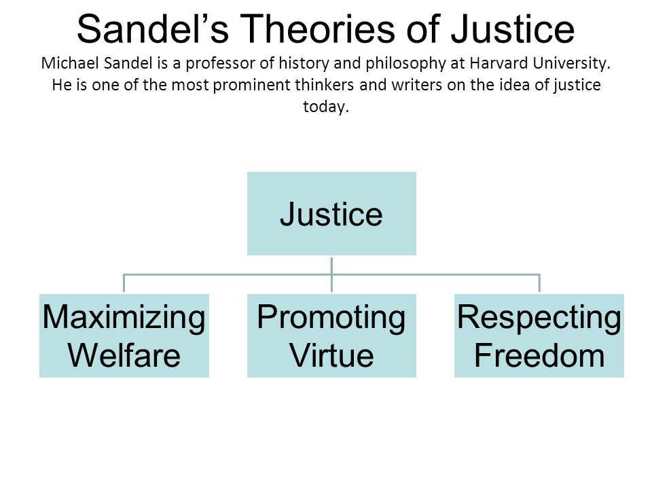

Slide 4
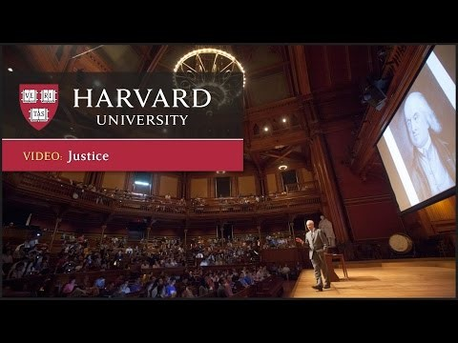
https://www.youtube.com/watch?v=0O2Rq4HJBxw&list=PL30C13C91CFFEFEA6

Slide 5



Slide 6
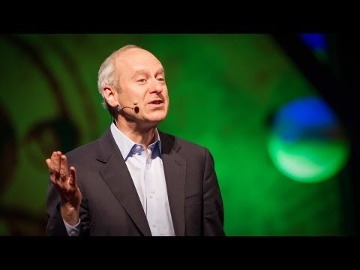
https://www.youtube.com/watch?v=GvDpYHyBlgc

Slide 7




Slide 8
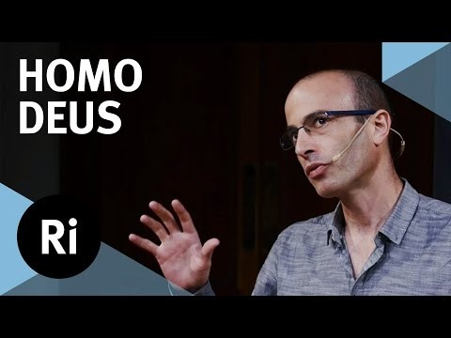
https://www.youtube.com/watch?v=4ChHc5jhZxs

Slide 9


Slide 10



$$≫$$

Slide 11
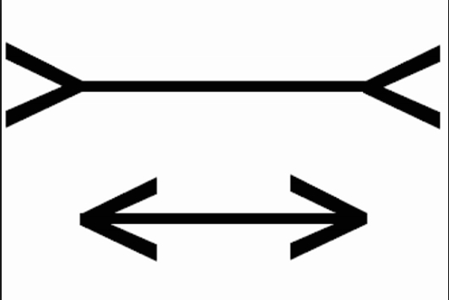


Slide 12
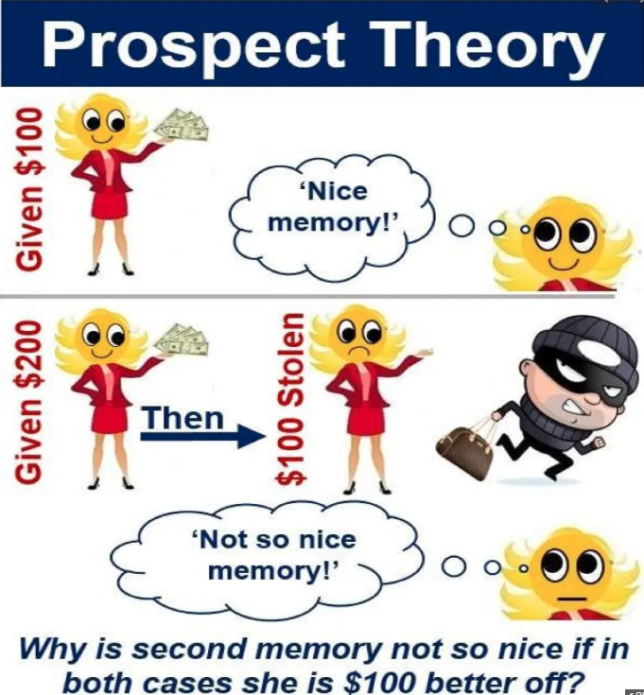


Slide 13
Engineering vs. Eng. Economy
Value added
Engineer
Engineering (ABET)
The Profession in which a knowledge of the mathematical and natural sciences gained by study, experience, and practice is applied with judgement to develop ways to utilize, economically, the materials and forces of nature for the benefit of mankind
Value added
Service
applications
engineering
science
Science

Slide 14
Engineering vs. Eng. Economy
Economic Efficiency
System Worth / System Cost > 1
♣ cf. Physical Efficiency = output / input ( < 1)
Engineering Economy
A systematic evaluation of the economic merits (benefit-cost) of proposed solutions to engineering projects
Provides technical solutions with economic justification
1999~2006 National Finance Act
: More than ₩50B(Gross) or ₩30B
(Government Only)
Preliminary Feasibility Study
Technical
Analysis
Political Analysis
Economic Analysis

Slide 15
Eng. Economy Procedures
Define the problem(Engineer)
Find the solutions (Engineer)
Decision Making (E. economist)
Quantitative: B/C ratio, NPV,..
Qualitative: AHP,Delphi,..
Economic Evaluation
Presentation (E. economist)
Provide Rational Principles and
Systematic Analysis Methods
Preliminary
Feasibility
Analysis

Slide 16
Engineering Economy
Objective – Evaluation
How to compare the economic value of alternative design options?
Basis – Cash Flow Analysis
Equivalence occurs when one is indifferent between two sets of cash flows
Key Issues
Time Value of Money
Cash flows occurring at different times
Designs with different durations

Slide 17

Time Value of Money
Value of money changes over time!!!
Interest & Interest Rate
Interest : Manifestation of TVM
Interest Rate = Interest / Principal
How to determine Interest Rate ?
risk cost, opportunity cost, inflation, financing cost
……
Please,
lend me ₩500
OK, but
₩ 550
in return

Slide 18

Examples

Slide 19
An Example of Cash Flow

Slide 20
Procedures for Economic Analysis
Environmental
(Political) Analysis
Cost Analysis
Economic Analysis
Technology Feasibility Analysis
Benefit Analysis
Economic Justification
- NPV, IRR, PB
- ROI
- B/C ratio

Slide 21
E.E., Accounting, Finance
Accounting vs. E.E.
Past Cashier Records vs. Future Investment Estimation
Ex-Post vs. Ex-Ante
Integrity vs. Accuracy
Historian vs. Fortune teller
Finance vs. E.E.
Fund Mgmt & Financial Investment vs. Project Investment
Financing, Stock& Bond Issue, M&A vs. New Technology & Business Investment
Need All the Answers!

Slide 22



Basics of Economics

Slide 23
Thank you !

